Slide 1
TAC Supported Scripts # 1 AMP4e to FMC Host Input Script
Anand Kanani – TME
Stealthwatch, AMP and Security APIs

Slide 2
Agenda
About the program – TAC supported scripts
Understand the function of - AMP4e to FMC Host Input Script
Setup / Configuration
Demo
Troubleshooting
Questions

Slide 3
About the script
This script imports all the operating systems (OS) information and vulnerable software detections from AMP for Endpoints (A4E) console using the A4E API, prints the output to a CSV and then imports the CSV into Firepower Management Center (FMC) using the Host Input API of FMC.
AMP for Endpoints (A4E) keeps a track of OS info and looks up for the CVEs associated with several commonly seen applications on the Endpoints, and reports them on its console as a proactive security feature called "Vulnerable Software"
Firepower Management Center (FMC) builds and maintains "Host Profiles", based on all the information it learns directly or indirectly about the hosts on the network. Based on these Host Profiles, FMC provides better tailored IPS Signature recommendations - which ones to enable/disable

Slide 4
Dependencies / Pre-Requisites
This script can to be executed on any host running Windows / Linux. (Not tested on Mac – it may work). This script WILL NOT WORK if directly executed on FMC
Account on AMP for Endpoints Public cloud and an API key generated. Read-only API key is fine. This may not work with AMP Private Cloud.
Firepower Management Center (FMC) 5.4+
Requires both Python and Perl - Python 2.7+ or Python 3.6+, AND Perl 5. This script is written in Python, so Python is required; whereas this script leverages the FMC Host Input SDK, which is written in Perl, so Perl is required
Python 'requests' module
Update the 'parameters.json' FILE WITH THE DETAILS BEFORE EXECUTING THIS SCRIPT
TCP port 443 to AMP for Endpoints API FQDN
TCP port 8307 to FMC
FMC Host Input API client certificate file (xxxxxx.pkcs12) generated from FMC, downloaded in this script's local directory

Slide 5
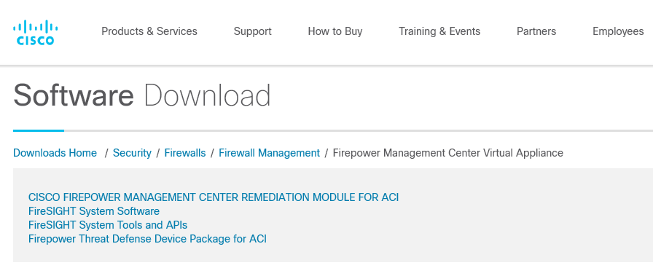
Download Location
To be decided and worked upon. But most likely it would be here

Slide 6
How to Setup
Identify the HOST where you are going to run this script
Install – Python (+ requests module) and Perl as per the pre-requisites list. Python Requests module can be installed by executing the command “python -m pip install requests"
Download the script files and extract the tar.gz
Generate A4E API Key
Generate the Host Input Client Certificate. To generate the certificate, login to FMC Web GUI and navigate to System -> Integrations -> Host Input Client -> Create Client -> give the IP address of your HOST and DO NOT GIVE a password -> Save. Download the pkcs12 file in this script's local directory
Update the parameters.json file with the details asked.
Note that you DO NOT have specify the name of the pkcs12 certificate file anywhere in the parameters.json file. The file is picked up automatically by the FMC Host Input SDK. Hence ensure that there is ONLY ONE pkcs12 file in the local directory
Check the reachability to AMP API console on TCP port 443 and to FMC on TCP port 8307 using telnet command, if required

Slide 7
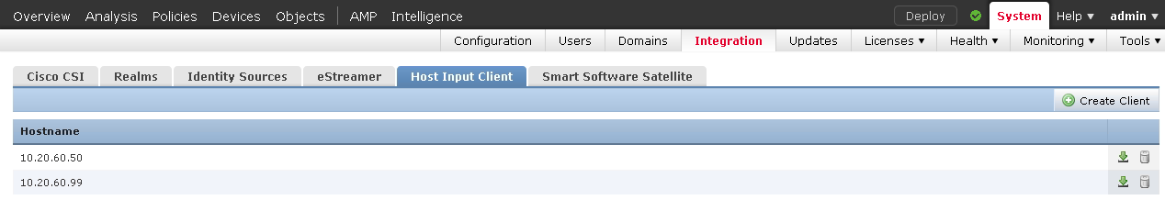
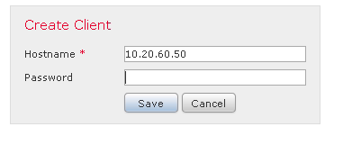
Screenshot – Setup Host Input Client Certificate in FMC GUI

Slide 8
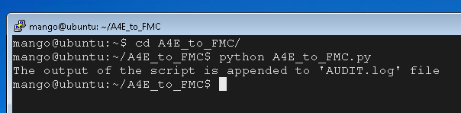
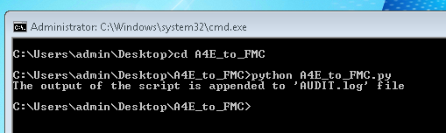
How to Execute / Use
Assuming that you have completed ALL the pre-requisites set in place, execute the script on CLI as shown below
All the activities of the script are logged to a file called AUDIT.log file. The file is not over-written, only appended. This includes all INFO and ERROR messages.
Only SHOWSTOPPER errors, if any, are also displayed on the screen.

Slide 9
Cisco Internal GitHub Link
https://wwwin-gitlab-sjc.cisco.com/ankanani/AMP4e-to-FMC-Host-Input-Script

Slide 10
Lab Testing
To test in the lab you need the following:
AMP for Endpoints account. Cisco employees can get an account from here - https://cisco.jiveon.com/docs/DOC-1770301#Steps-to-Get-Your-AMP-for-Endpoints-Account---AMP-101
A4E must have more or more connectors (agents) deployed on some endpoints for several days, so that Vulnerable Software Detections events are fired.
FMC
Any laptop / VM with the pre-requisites installed to run this script

Slide 11
Demo Time

Slide 12
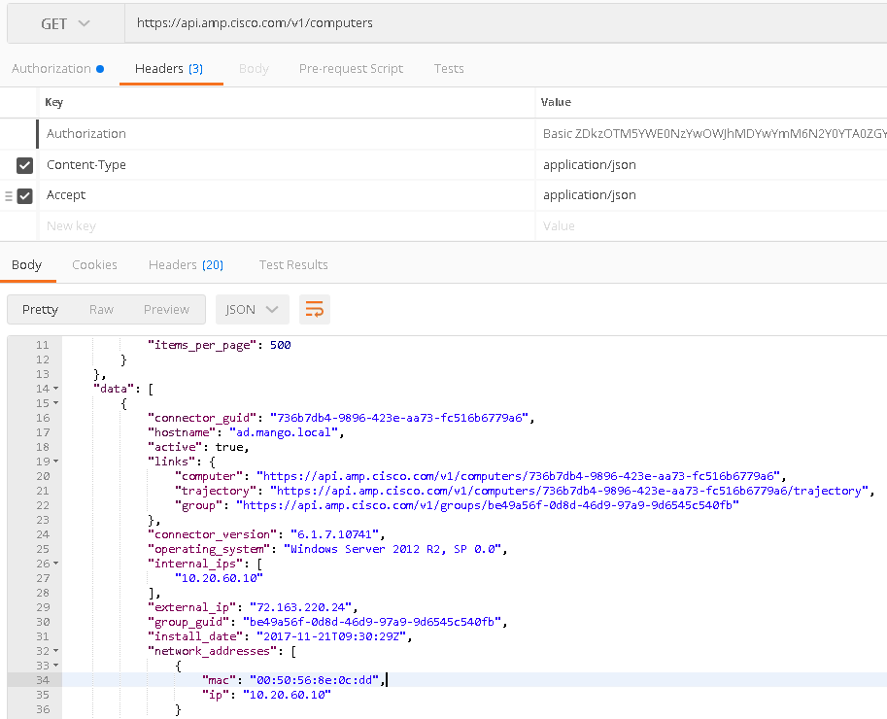
Screenshot – OS Data on AMP for Endpoints in API
API Call -
https://api.amp.cisco.com/v1/computers
Info like Internal IP, MAC and OS are picked up from here. Service Pack info from the OS Name is dropped while parsing.
Note that API FQDN is different for NAM, EU and APJ Clouds
Screenshot taken using Postman

Slide 13
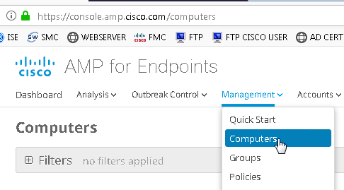
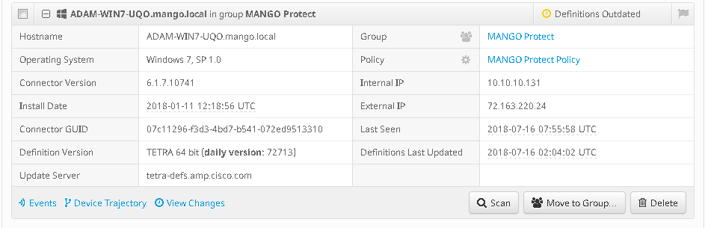
Screenshot – OS Data on AMP for Endpoints in GUI

Slide 14

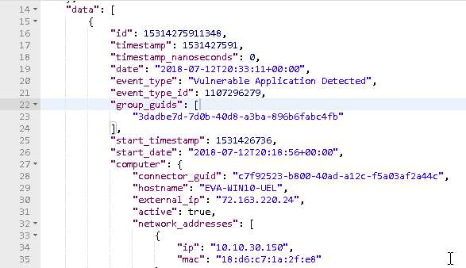
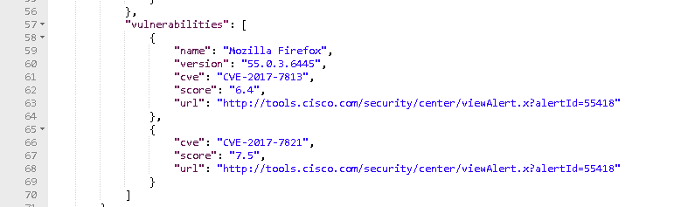
Screenshot – Vulnerable Software Detection Events on AMP for Endpoints in API
API Call -
https://api.amp.cisco.com/v1/events
https://api.amp.cisco.com/v1/events?event_type[]=xxxxx&group_guid[]=yyyy&group_guid=zzzzz
Info like Internal IP, CVE, Application Name and Version are picked up from here
Screenshot taken using Postman

Slide 15
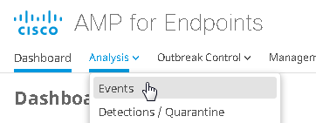
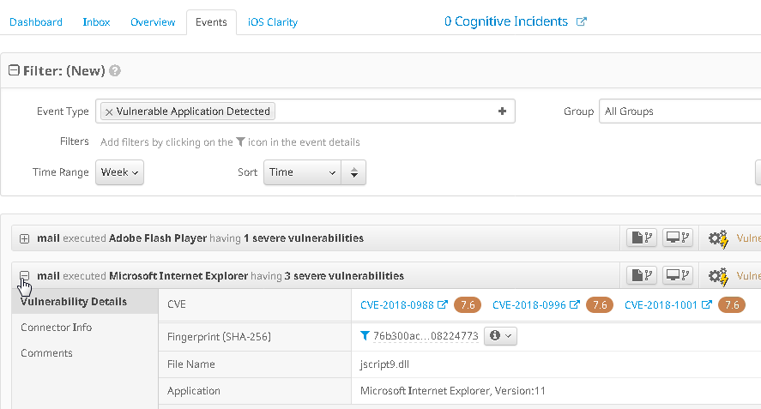
Screenshot – Vulnerable Software Detection Events on AMP for Endpoints in GUI

Slide 16
Recommendation around A4E groups selection
Select the groups associated with Endpoints having static IP addresses like Server segments and Desktops with static addresses

Slide 17
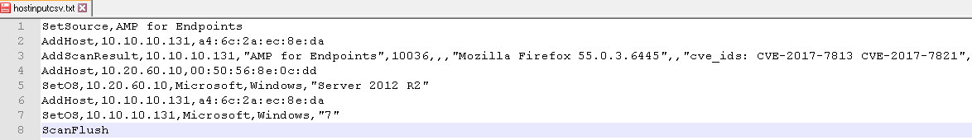
Screenshot – Host Input CSV File generated by this script
The last line will be either ScanFlush or ScanUpdate
ScanFlush – Overwrites the existing Vulnerability Scan Data for the Host in FMC
ScanUpdate – Adds/Deletes to the existing Vulnerability Scan Data for the Host in FMC
NOTE that the script will affect only the Vulnerability Scan Data for the Hosts that are mentioned in this script. It will not affect the other hosts

Slide 18
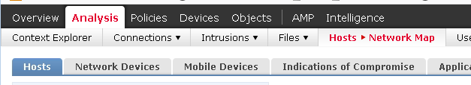
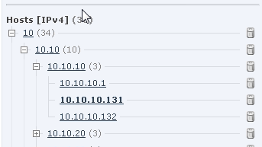
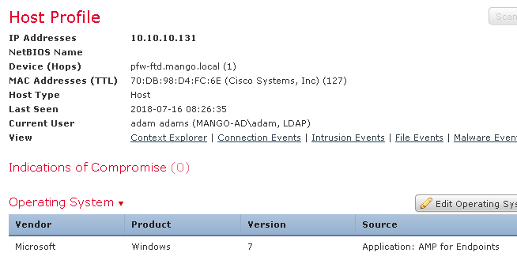
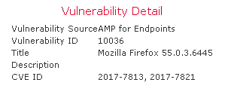
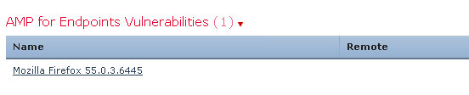
Screenshot – OS and Vulnerability Data in FMC GUI

Slide 19
Common Issues
The users are NOT SUPPOSED TO MODIFY any files other than the parameters.json. You can do a comparison of original and user’s files using sha1 checksum or using software like WinMerge
If the parameters.json file is not correct either in terms of format (like missing commas or missing brackets) or in terms of values (like missing variable or empty variable) provided, then the script will throw either a compiletime or runtime error, respectively. Check the sample-parameters.json file and fix the errors, if any
Check that the FMC IP address is provided in parameters.json. FMC Hostname will not work
The runtime errors are logged in AUDIT.log file. Check the log for clues
If there are multiple pkcs12 files, then the script will fail to connect to FMC. Solution is to keep only ONE pkcs12 file in the script’s local directory
Check that the script is reachable to AMP for Endpoints FQDN on TCP port 443 and FMC on TCP port 8307

Slide 20
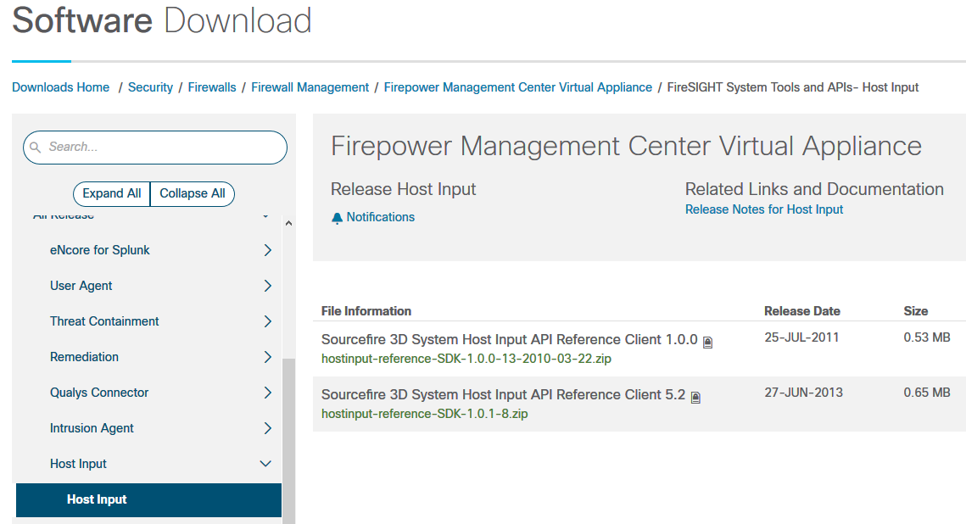
Note about FMC Host Input API SDK
The FMC Host Input SDK Files are downloaded from here and used in this script:
https://software.cisco.com/download/home/286259687/type/286271057/release/Host%20Input
All the .pl and .pm files in this SDK have been slightly modified. As a part of this modification, only the below line is added in the beginning of all the .pl and .pm files. Nothing else is changed in the SDK

Slide 21
References
AMP for Endpoints API Documentation
http://api-docs.amp.cisco.com/
FMC Host Input API SDK Documentation
https://www.cisco.com/c/en/us/td/docs/security/firepower/60/api/host-input/HostInputAPIGuide/Intro.html

Slide 22
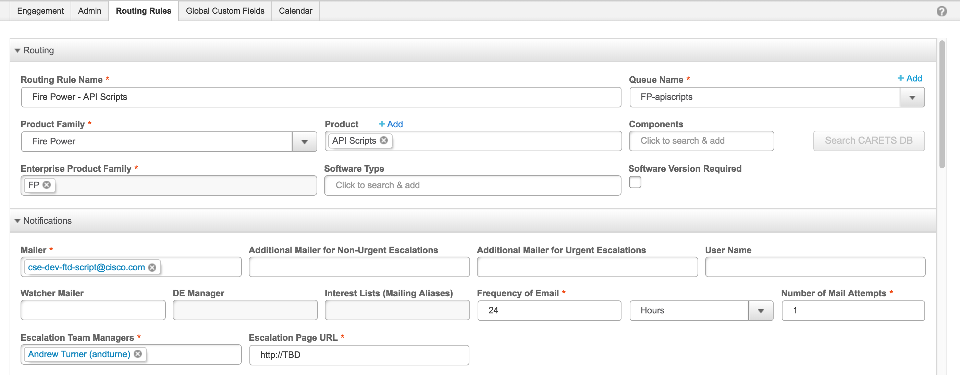
TAC Escalation Process
BEMS Screenshot
Escalation Team Alias - cse-dev-ftd-script@cisco.com

Slide 23
Questions

